Slide 1
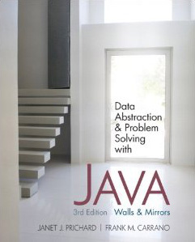
Chapter 2
Principles of Programming & Software Engineering
© 2011 Pearson Addison-Wesley. All rights reserved
2-<number>

Slide 2
Problem Solving and Software Engineering
Coding without a solution design increases debugging time
A team of programmers is needed for a large software development project
Teamwork requires:
  An overall plan
  Organization
  Communication
Software engineering
  Provides techniques to facilitate the development of computer programs
© 2011 Pearson Addison-Wesley. All rights reserved
2-<number>

Slide 3
What is Problem Solving?
Problem solving
  The process of taking the statement of a problem and developing a computer program that solves that problem
A solution consists of:
  Algorithms
    Algorithm: a step-by-step specification of a method to solve a problem within a finite amount of time
  Ways to store data
© 2011 Pearson Addison-Wesley. All rights reserved
2-<number>

Slide 4
The Life Cycle of Software
The life cycle of a software
  A lengthy and continuing process
  Required for the development of good software
  Programmer can move from any phase of the cycle to any other phase
© 2011 Pearson Addison-Wesley. All rights reserved
2-<number>

Slide 5
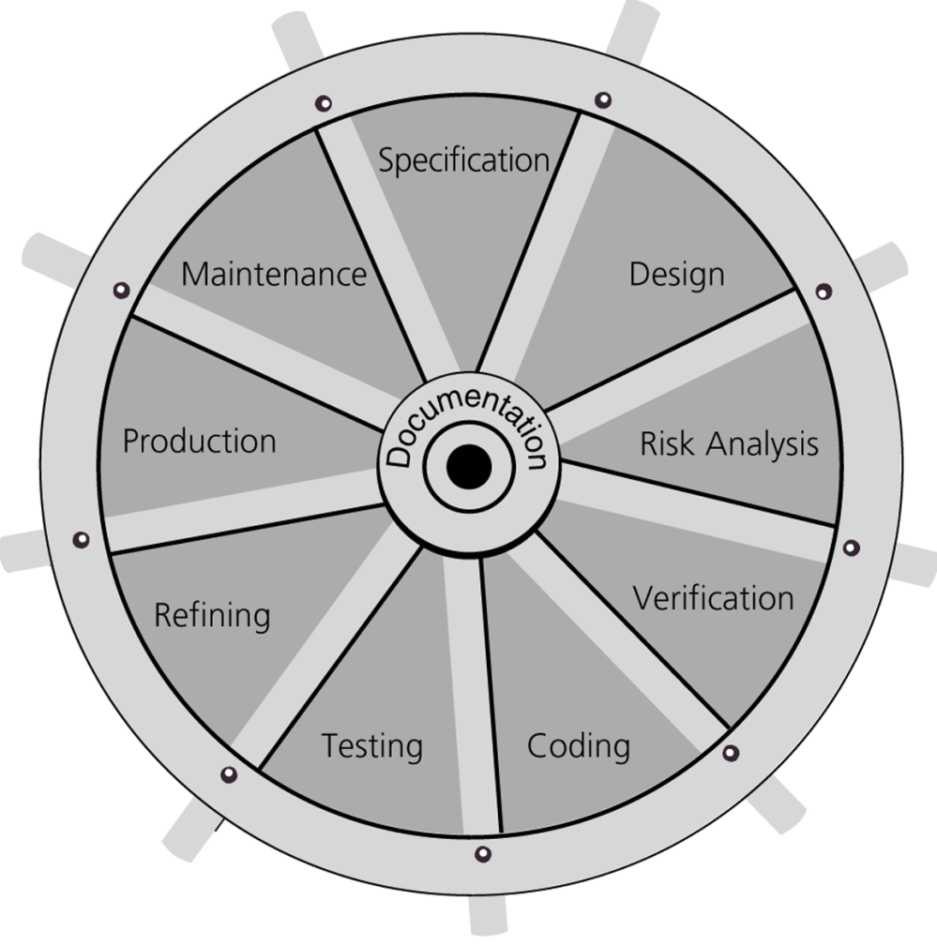
The Life Cycle of Software
Figure 2-1
The life cycle of software as a water wheel that can rotate from one phase to any other phase
© 2011 Pearson Addison-Wesley. All rights reserved
2-<number>

Slide 6
The Life Cycle of Software
Phase 1: Specification
  Aspects of the problem which must be specified:
    What is the input data?
    What data is valid and what data is invalid?
    Who will use the software, and what user interface should be used?
    What error detection and error messages are desirable?
    What assumptions are possible?
    Are there special cases?
    What is the form of the output?
    What documentation is necessary?
    What enhancements to the program are likely in the future?
© 2011 Pearson Addison-Wesley. All rights reserved
2-<number>

Slide 7
The Life Cycle of Software
Phase 1: Specification (Continued)
  Prototype program
    A program that simulates the behavior of portions of the desired software product
Phase 2: Design
  Includes:
    Dividing the program into modules
    Specifying the purpose of each module
    Specifying the data flow among modules
© 2011 Pearson Addison-Wesley. All rights reserved
2-<number>

Slide 8
The Life Cycle of Software
Phase 2: Design (Continued)
  Modules
    Self-contained units of code
    Should be designed to be:
      Loosely coupled
      Highly cohesive
  Interfaces
    Communication mechanisms among modules
© 2011 Pearson Addison-Wesley. All rights reserved
2-<number>

Slide 9
The Life Cycle of Software
Phase 2: Design (Continued)
  Specifications of a method
    A contract between the method and the module that calls it
    Should not commit the method to a particular way of performing its task
    Include the method’s:
      Precondition
        A statement of the conditions that must exist at the beginning of the method
      Postcondition
        A statement of the conditions at the end of the method
© 2011 Pearson Addison-Wesley. All rights reserved
2-<number>

Slide 10
The Life Cycle of Software
Phase 3: Risk Analysis
  Building software entails risks
  Techniques exist to identify, assess, and manage the risks of creating a software product
Phase 4: Verification
  Formal methods can be used to prove that an algorithm is correct
  Assertion
    A statement about a particular condition at a certain point in an algorithm
    Java’s assert statement: assert booleanExpression;
© 2011 Pearson Addison-Wesley. All rights reserved
2-<number>

Slide 11
The Life Cycle of Software
Phase 4: Verification (Continued)
  Invariant
    A condition that is always true at a particular point in an algorithm
  Loop invariant
    A condition that is true before and after each execution of an algorithm’s loop
    Can be used to detect errors before coding is started
© 2011 Pearson Addison-Wesley. All rights reserved
2-<number>

Slide 12
The Life Cycle of Software
Phase 4: Verification (Continued)
  The invariant for a correct loop is true:
    Initially, after any initialization steps, but before the loop begins execution
    Before every iteration of the loop
    After every iteration of the loop
    After the loop terminates
Phase 5: Coding
  Involves:
    Translating the design into a particular programming language
    Removing syntax errors
© 2011 Pearson Addison-Wesley. All rights reserved
2-<number>

Slide 13
The Life Cycle of Software
Phase 6: Testing
  Involves:
    Removing the logical errors
  Test data should include:
    Valid data that leads to a known result
    Invalid data
    Random data
    Actual data
© 2011 Pearson Addison-Wesley. All rights reserved
2-<number>

Slide 14
The Life Cycle of Software
Phase 7: Refining the Solution
  During phases 1 through 6
    A working program is developed under simplifying assumptions
  During phase 7
    Refining sophistication is added, such as:
      More sophisticated input and output routines
      Additional features
      More error checks
© 2011 Pearson Addison-Wesley. All rights reserved
2-<number>

Slide 15
The Life Cycle of Software
Phase 8: Production
  Involves:
    Distribution to the intended users
    Use by the users
Phase 9: Maintenance
  Involves
    Correcting user-detected errors
    Adding more features
    Modifying existing portions to suit the users better
© 2011 Pearson Addison-Wesley. All rights reserved
2-<number>

Slide 16
What is a Good Solution?
A solution is good if:
  The total cost it incurs over all phases of its life cycle is minimal
The cost of a solution includes:
  Computer resources that the program consumes
  Difficulties encountered by those who use the program
  Consequences of a program that does not behave correctly
Programs must be well structured and documented
Efficiency is only one aspect of a solution’s cost
© 2011 Pearson Addison-Wesley. All rights reserved
2-<number>

Slide 17
Achieving an Object-Oriented Design: Abstraction and Information Hiding
A modular solution to a problem should specify what to do, not how to do it
Abstraction
  Separates the purpose of a module from its implementation
Procedural abstraction
  Separates the purpose of a method from its implementation
© 2011 Pearson Addison-Wesley. All rights reserved
2-<number>

Slide 18
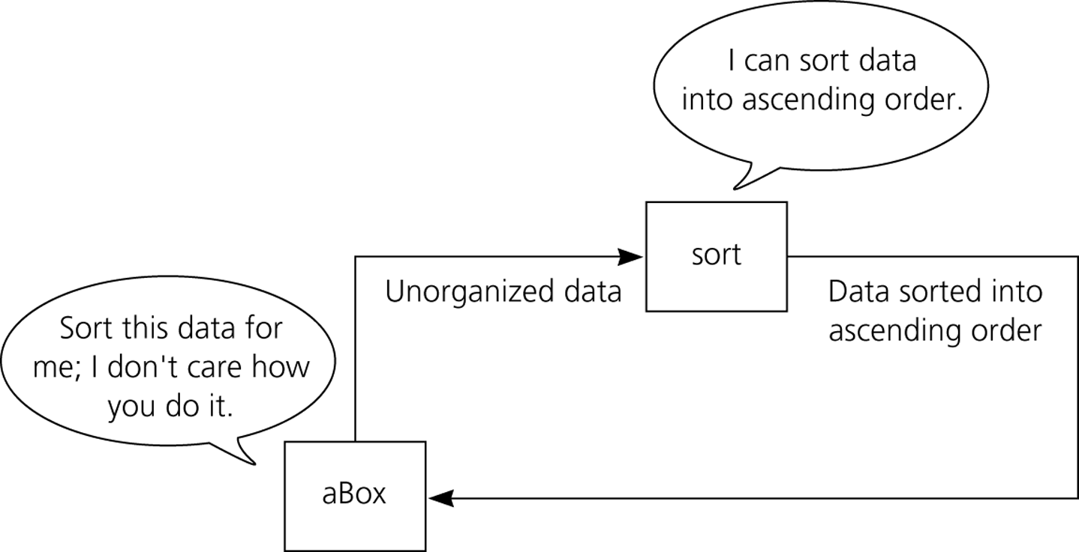
Abstraction and Information Hiding
Figure 2-2
The details of the sorting algorithm are hidden from other parts of the solution.
© 2011 Pearson Addison-Wesley. All rights reserved
2-<number>

Slide 19
Abstraction and Information Hiding
Data abstraction
  Focuses of the operations of data, not on the implementation of the operations
  Abstract data type (ADT)
    A collection of data and a set of operations on the data
    An ADT’s operations can be used without knowing how the operations are implemented, if:
      the operations’ specifications are known
  Data structure
    A construct that can be defined within a programming language to store a collection of data
© 2011 Pearson Addison-Wesley. All rights reserved
2-<number>

Slide 20
Abstraction and Information Hiding
Public view of a module
  Described by its specifications
Private view of a module
  Consists of details which should not be described by the specifications
Principle of information hiding
  Hide details within a module
  Ensure that no other module can tamper with these hidden details
© 2011 Pearson Addison-Wesley. All rights reserved
2-<number>

Slide 21
Object-Oriented Design
Object-oriented approach to modularity
  Produces a collection of objects that have behaviors
Object
  An instance of a class
  Combines data and operations on that data
Encapsulation
  A technique that hides inner details
  Methods encapsulate actions
  Objects encapsulate data as well as actions
© 2011 Pearson Addison-Wesley. All rights reserved
2-<number>

Slide 22
Object-Oriented Design
Principles of object-oriented programming (OOP)
  Encapsulation
    Objects combine data and operations
  Inheritance
    Classes can inherit properties from other classes
  Polymorphism
    Objects can determine appropriate operations at execution time
© 2011 Pearson Addison-Wesley. All rights reserved
2-<number>

Slide 23
Functional Decomposition
Object-oriented design (OOD)
  Produces modular solutions for problems that primarily involve data
  Identifies objects by focusing on the nouns in the problem statement
Functional Decomposition (FD)
  Produces modular solutions for problems in which the emphasis is on the algorithms
  Identifies actions by focusing on the verbs in the problem statement
  A task is addressed at successively lower levels of detail
© 2011 Pearson Addison-Wesley. All rights reserved
2-<number>

Slide 24
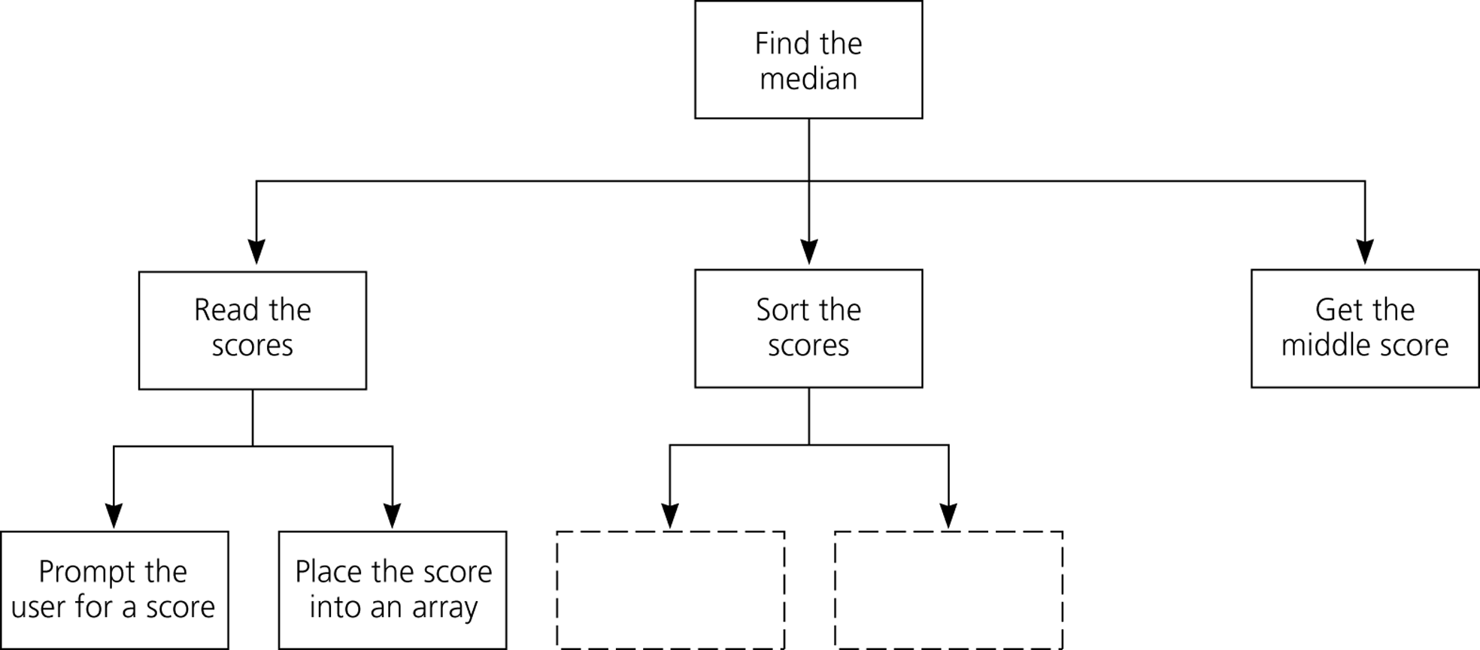
Functional Decomposition
Figure 2-4
A structure chart showing the hierarchy of modules
© 2011 Pearson Addison-Wesley. All rights reserved
2-<number>

Slide 25
General Design Guidelines
Use OOD and FD together
Use OOD for problems that primarily involve data
Use FD to design algorithms for an object’s operations
Consider FD to design solutions to problems that emphasize algorithms over data
Focus on what, not how, when designing both ADTs and algorithms
Consider incorporating previously written software components into your design
© 2011 Pearson Addison-Wesley. All rights reserved
2-<number>

Slide 26
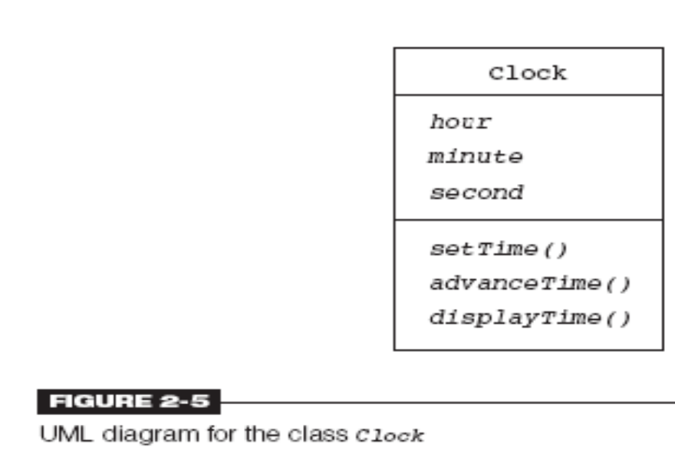
Modeling Object-Oriented Designs Using IML
Unified Modeling Language (UML): language to express OO designs
Class diagrams include name, data, operations
Text-based notation: more complete specifications
© 2011 Pearson Addison-Wesley. All rights reserved
2-<number>

Slide 27
A Summary of Key Issues in Programming
Modularity
  Favorable impact on program development
Modifiability
  Use of methods and named constants
Ease of Use
  Considerations for the user interface
    Program should prompt the user for input
    A program should always echo its input
    The output should be well labeled and easy to read
© 2011 Pearson Addison-Wesley. All rights reserved
2-<number>

Slide 28
A Summary of Key Issues in Programming
Fail-Safe Programming
  Fail-safe program
    A program that will perform reasonably no matter how anyone uses it
  Types of errors:
    Errors in input data
    Errors in the program logic
© 2011 Pearson Addison-Wesley. All rights reserved
2-<number>

Slide 29
A Summary of Key Issues in Programming
Style
  Five issues of style
    Extensive use of methods
    Use of private data fields
    Error handling
    Readability
    Documentation
© 2011 Pearson Addison-Wesley. All rights reserved
2-<number>

Slide 30
A Summary of Key Issues in Programming
Debugging
  Programmer must systematically check a program’s logic to determine where an error occurs
  Tools to use while debugging:
    Watches
    Breakpoints
    System.out.println statements
    Dump methods
© 2011 Pearson Addison-Wesley. All rights reserved
2-<number>

Slide 31
Summary
Software engineering studies ways to facilitate the development of computer programs
Software life cycle consists of:
  Specifying the problem
  Designing the algorithm
  Analyzing the risks
  Verifying the algorithm
  Coding the programs
  Testing the programs
  Refining the solution
  Using the solution
  Maintaining the software
© 2011 Pearson Addison-Wesley. All rights reserved
2-<number>

Slide 32
Summary
A loop invariant is a property of an algorithm that is true before and after each iteration of a loop
An evaluation of the quality of a solution must take into consideration
  The solution’s correctness
  The solution’s efficiency
  The time that went into the development of the solution
  The solution’s ease of use
  The cost of modifying and expanding the solution
© 2011 Pearson Addison-Wesley. All rights reserved
2-<number>

Slide 33
Summary
A combination of object-oriented and functional decomposition techniques will lead to a modular solution
The final solution should be as easy to modify as possible
A method should be as independent as possible and perform one well-defined task
A method should always include an initial comment that states its purpose, its precondition, and its postcondition
© 2011 Pearson Addison-Wesley. All rights reserved
2-<number>

Slide 34
Summary
A program should be as fail-safe as possible
Effective use of available diagnostic aids is one of the keys to debugging
To make it easier to examine the contents of complex data structures while debugging, dump methods that display the contents of the data structures should be used
© 2011 Pearson Addison-Wesley. All rights reserved
2-<number>

